Slide 1

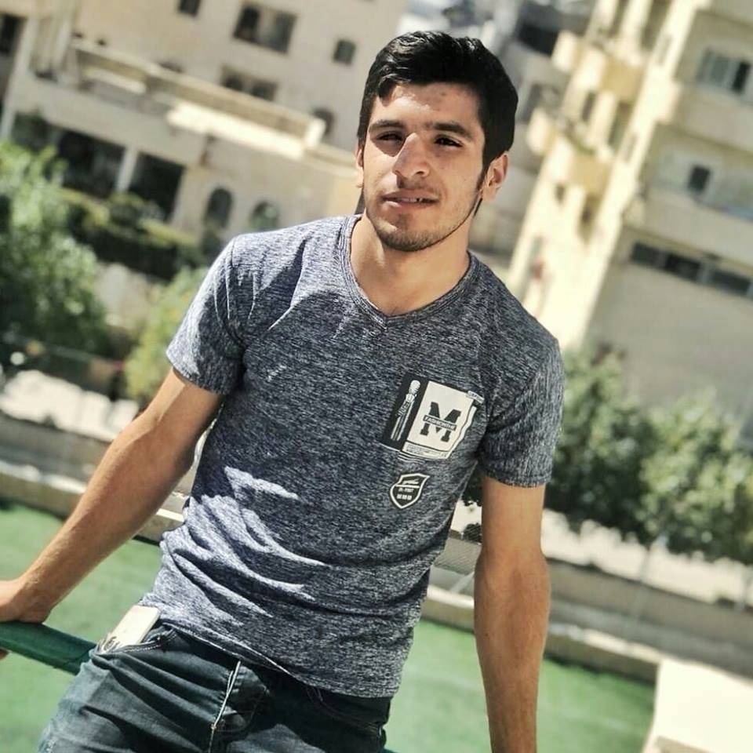
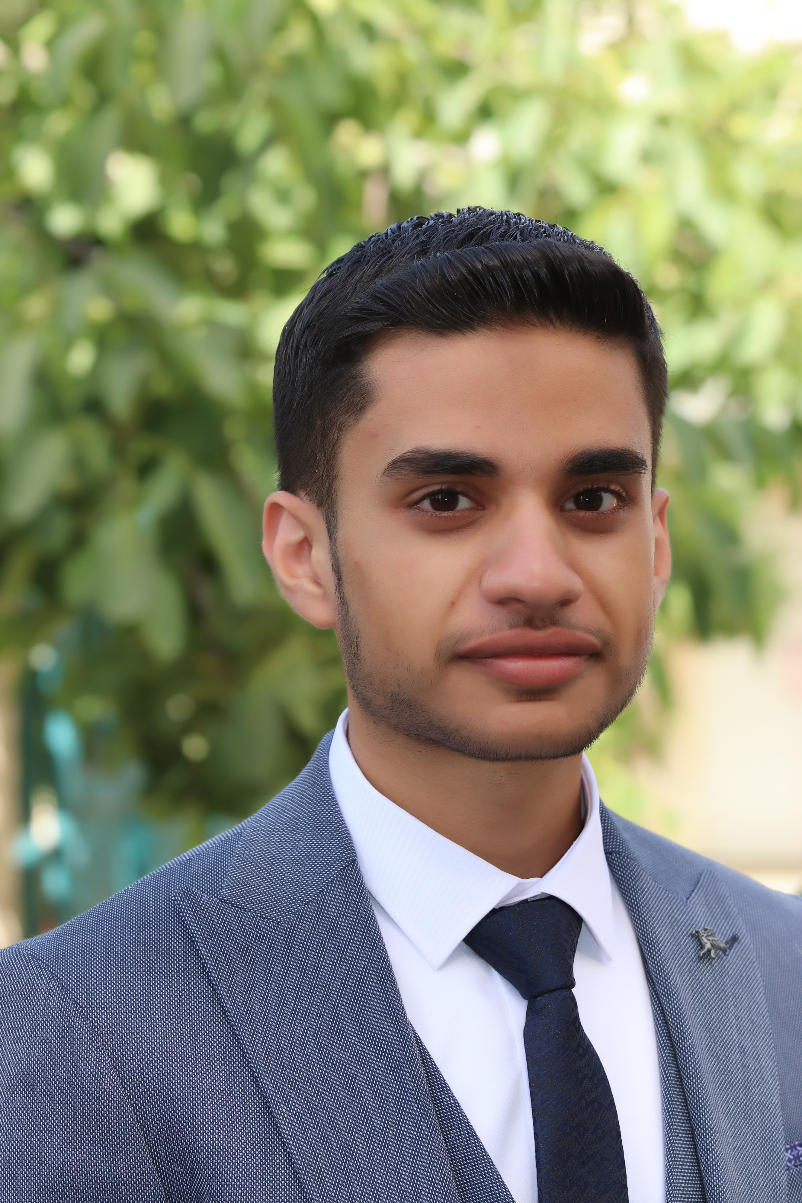
Coded by: - Faris abu3ram j. - Amir Altakroori
Project 1:
Sticky Notes
(student & software dev. )
(student & software dev. )

Slide 2
Contents:
About project
Project features
For next Versions
Demo
Questions

Slide 3
Print all notes
Add new notes
Add user
Add password
Add full name
Login
Write your note
Write another note or exit
Login
View notes

Slide 4
Project Features:
Interactive background.
Adding Password.
Multiple notes.
Multiple lines.

Slide 5
For next Versions
Searching By:
Key word
Date
Mention
Modify
Delete
Labels

Slide 6
Demo

Slide 7
Contact with us.
Email: 201426@ppu.edu.ps
Phone: 059-9999999

